Slide 1
General Directorate of Animal Health and Production National Animal Health and Production Research Institute
Africa Swine Fever Situation and
Surveillance Activities in Cambodia
Ren Theary
Kampala, Uganda
February 7th -10th

Slide 2
Overview
ASF outbreak in Cambodia
Common Swine diseases in Cambodia
Objectives
ASF surveillance
Conclusion

Slide 3
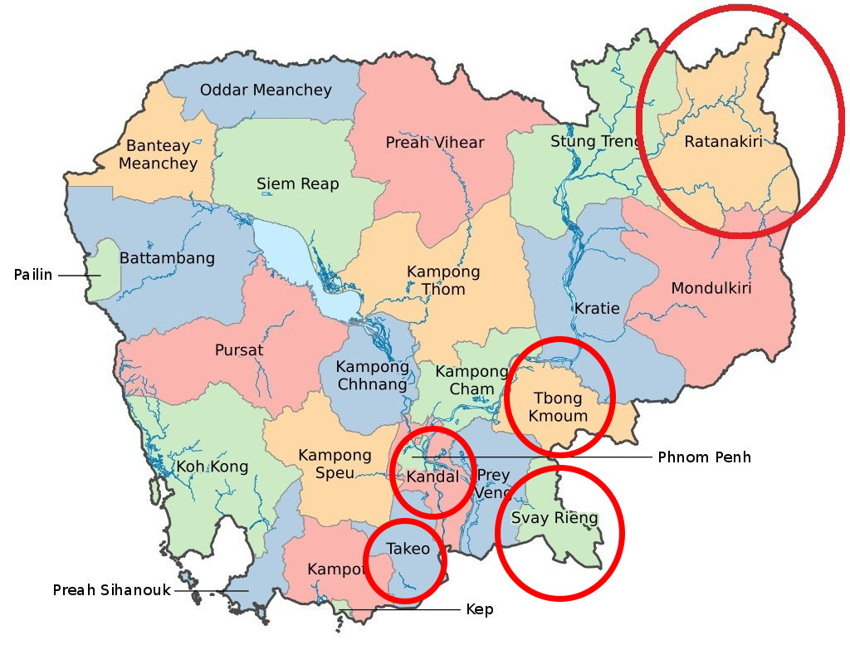
ASF outbreak in Cambodia
ASF outbreaks were detected in five provinces since
22 March to 10 July 2019.

Slide 4
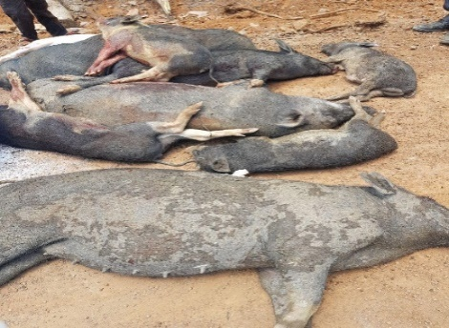
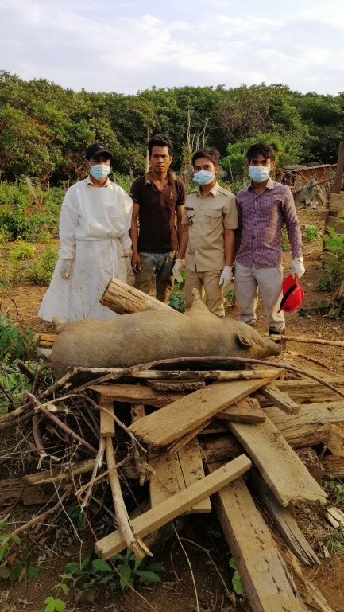
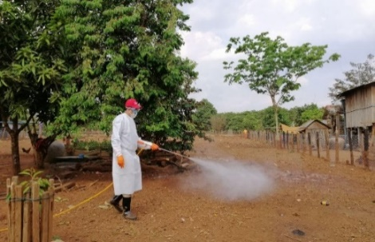
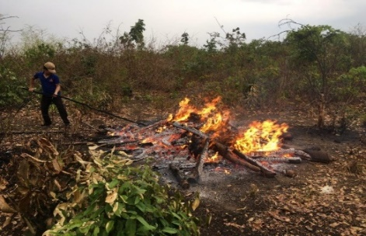
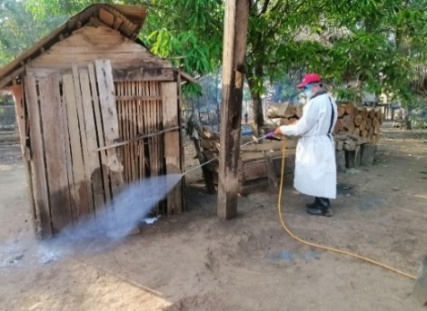
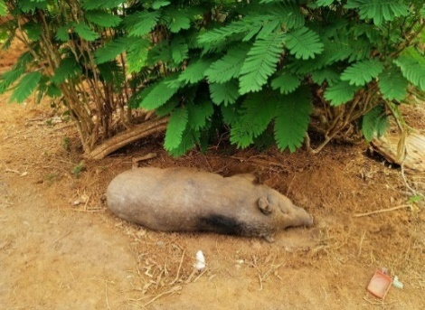
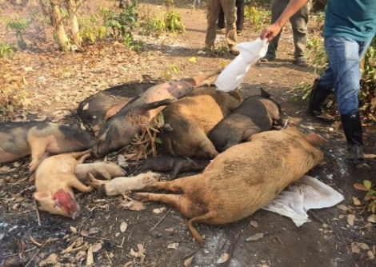
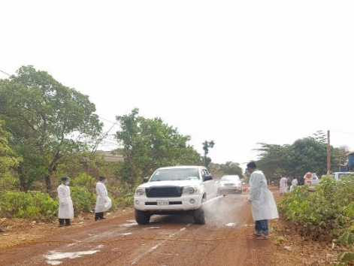
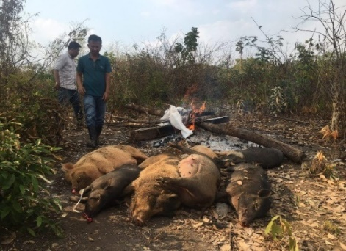
Outbreak containment team in Ratanakiri province
Total Culling 331 heads
Disinfected households and slaughterhouses

Slide 5
Common Diseases of Cambodian Pigs
Viral Diseases: FMD, CSF, Aujesky’s, PCV, SIV, PRRS, PED, TGE
Bacterial diseases: Salmonella, Pasteurella, Mycoplasma, Escherichia Coli, Streptococcus suis, Erysipelas
Parasites: Intestinal worms, Lice and/or mange, Coccidiosis
Notes:
Porcine Circo Virus (PCV), Swine Influenza Virus (SIV), Porcine Reproductive and Respiratory Syndrome (PRRS), Porcine Epidemic Diarrhea (PED), Transmissible Gastroenteritis (TGE)

Slide 6
Objectives
To detect the presence of the ASF virus in pigs
To prevent ASF outbreaks and minimize the risk of ASF incursions
Identify possible risk factors for the emergence and spread of ASF in pig farming
To determine seroprevalences of endemic high-impact diseases

Slide 7
ASF Surveillance

Slide 8
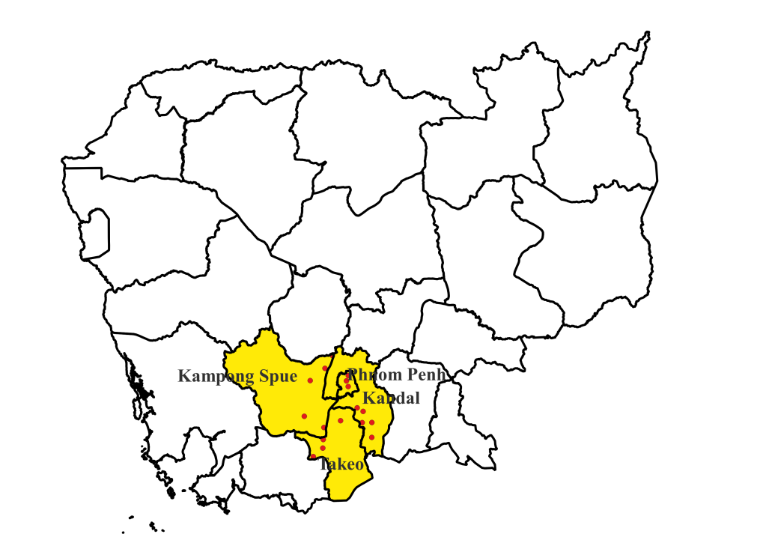
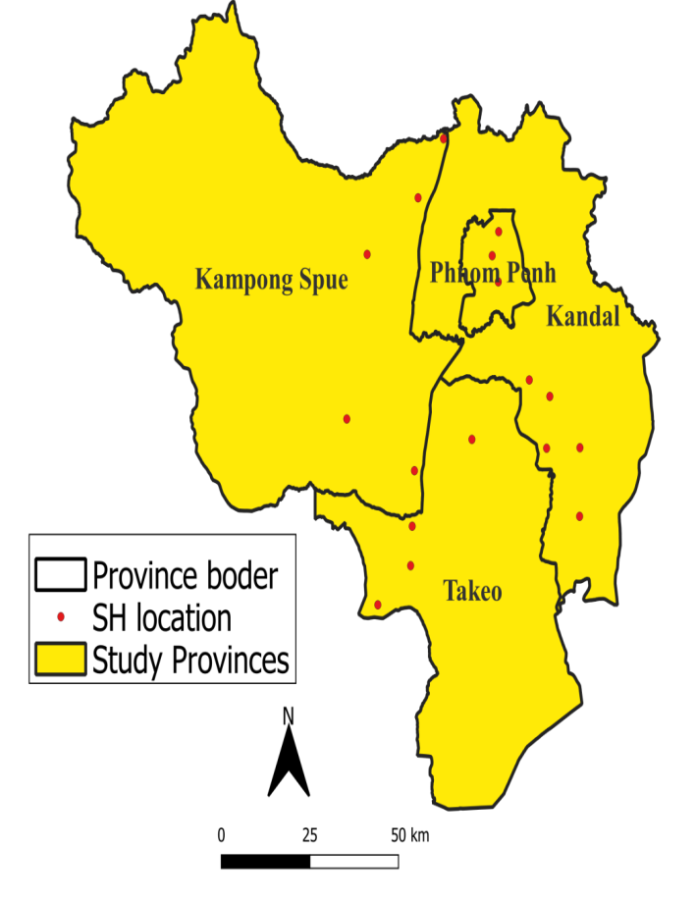
Studied areas
17 slaughterhouses in 4 provinces were selected
Kandal province (5 slaughterhouses)
Kampong Speu province (5 slaughterhouses)
Takeo province (4 slaughterhouses)
Phnom Penh (3 slaughterhouses)

Slide 9
Methods
Studied period: 2020 – 2022
Pig sampling preparation
Determine how many pigs to sample for this batch
Perform a systematic random sample and decide which pigs
to sample
Using a pre-calculated sample sizes for different pig batch sizes, to detect at least one animal positive with 95% CI, assuming prevalence 20% (sampled all pigs when batch size less than 9, and random 16 pigs when batch size more than 100)
Batch size | No. of animals to sampling
1 to 9 | Sample all
10 | 9
11 to 13 | 10
14 to 17 | 11
18 to 23 | 12
24 to 32 | 13
33 to 52 | 14
53 to 100 | 15
101 or above | 16

Slide 10
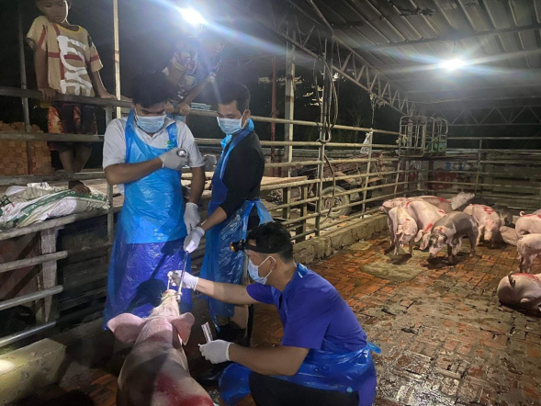
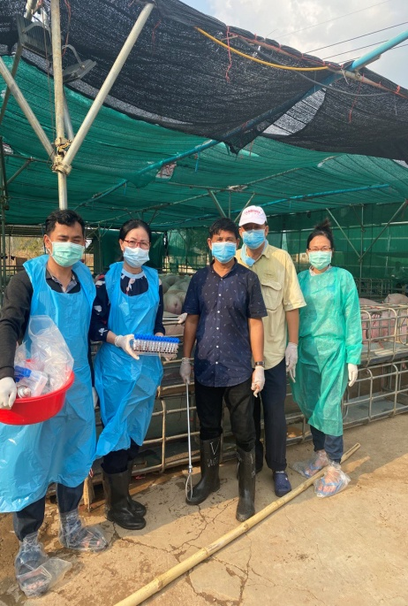
Samples Collection
Nasal swabs
Blood
Dry meat
Tick

Slide 11
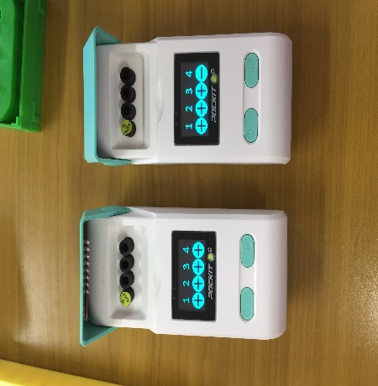
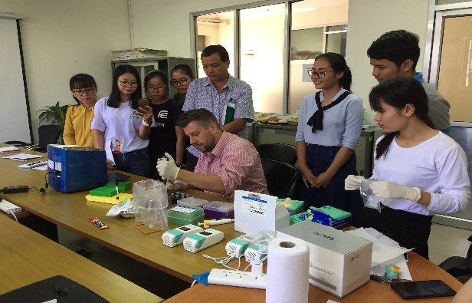
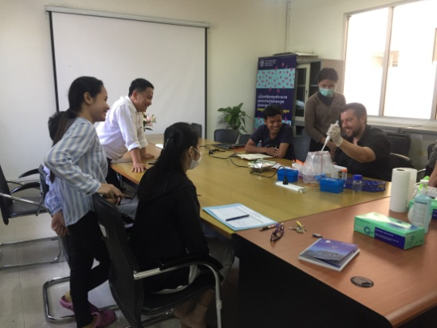
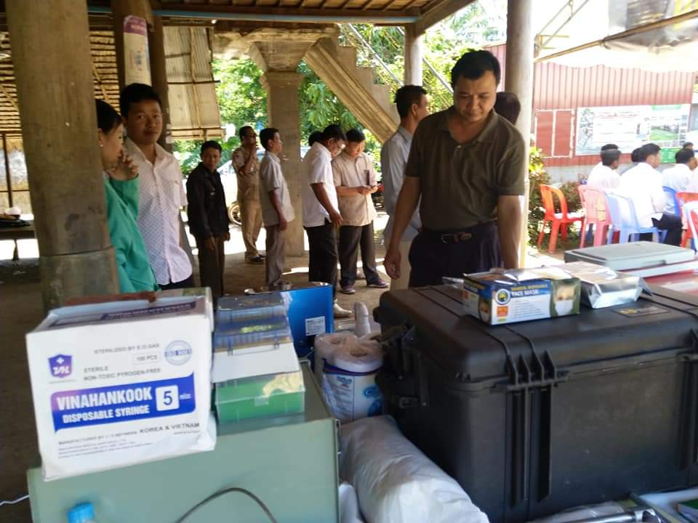
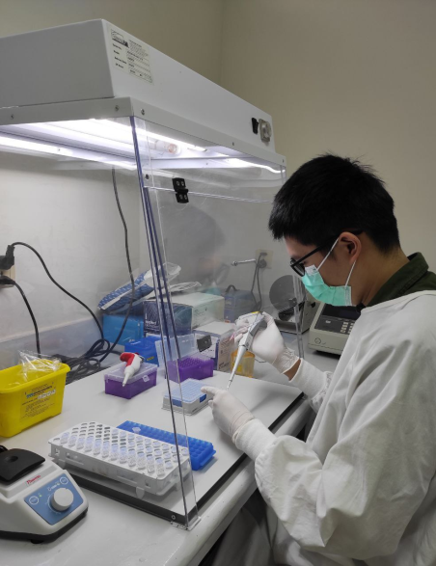
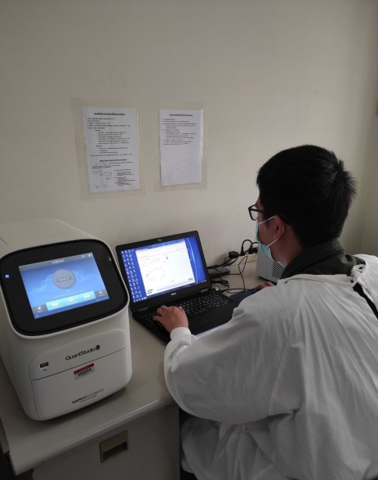
Diagnostic Methods
Using Real Time PCR to detect ASF
Mobile test units (Pockit Micro Plus) to areas with an outbreak of ASF with support from the FAO

Slide 12
Results (ASF)

Slide 13
Serological Surveillance for Swine diseases

Slide 14
Research Collaboration
National Animal Health and Production Research Institute (NAHPRI) with Mahidol-Oxford Tropical Medicine Research Unit (MORU)

Slide 15
Diagnostic Method
Using commercial antibody ELISA kits manufactured by IDvet, France were detected antibodies
Classical Swine Fever (CSF)
Porcine Reproductive and Respiratory Syndrome (PRRS)
African Swine Fever (ASF)

Slide 16
Sero-prevalence results
ASF as the overall number of seropositive samples was low. The variable that demonstrated significant differences between positive and negative results for ASF
The overall seroprevalence of CSF, PRRS, and ASF was high in a commercial farm
Conclusion: the CSF, PRRS are no vaccination history and vaccination programs for large commercial pig farms in Cambodia were not publicly available. Vaccines against CSF and PRRS are commonly used in pig production in South East Asia.

Slide 17
Challenges
Research capacity
Resources of human and Finance
Lab capacity in diagnosing (Lab supplies)

Slide 18
Way forwards
Strengthen surveillance system
Strengthen lab capacity
Enforce existing legislation on disease management
Improve Public Private Partnership collaboration

Slide 19
Conclusion
ASF is still threatening pig production in Cambodia.
The overall prevalence of ASF detected during the study period was 2.52%.
Economic consequence: In Cambodia, the first ASF outbreak was reported in April 2019 in five provinces. While an estimated 70% of ASF is widespread all over the country greater losses.

Slide 20
Thank You for your listening!

